Slide 1

HOLLYWOOD THEATRICAL MARKET SYNOPSIS 1995-2021 CASE STUDY
A Research Project by Nupur

Slide 2
CONTENT
CASE STUDY
OBJECTIVES
DATA ANALYSIS
ANALYSIS OF THE SYNOPSIS:
WALT DISNEY MOVIES
MOVIES WITH GENRE”ADVENTURE” & MPAA RATINGS “PG-13”
NUMBER OF MOVIES BASED ON TOP DISTRIBUTORS
TICKETS SOLD BASED ON AVERAGE TICKET PRICE
STAR WARS EPISODES
MARKET SHARE BASED ON TOP GENRES,TOP GROSSING RATINGS,TOP DISTRIBUTORS

Slide 3
CASE STUDY
This case study comprises of five datasets:
AnnualTicketSales-This table lists the tickets sold each year along with its total box office (including adjusted box office due to inflammation) and average ticket price.
HighestGrossers-This table lists the top grossing movie for each year based on the tickets sold for each movie during the course of that respective year and also its corresponding year 2019 valuation.
TopDistributors-It lists rankwise top distributors with respect to their market shares.
TopGenres-It lists rankwise top genres with respect to their market shares.
TopGrossingRatings-It lists rankwise MPAA Ratings with respect to their market shares.

Slide 4
ANALYSIS OF THE SYNOPSIS
This synopsis consists of five Datasets with their columns respectively-
ANNUAL TICKET SALES:-
HIGHEST GROSSERS:-
TOP GENRES:-
TOP GROSSING RATINGS:-
TOP DISTRIBUTORS:-
YEAR | TICKETS_SOLD | TOTAL_BOXOFFICE | TOTAL_INFLATION ADJUSTED | AVG_TICKETPRICE
YEAR | MOVIE | GENRE | MPAA_RATING | DISTRIBUTOR | TOTAL FOR YEAR | TOTALIN2019DOLLARS | TICKETS_SOLD
RANK | GENRES | MOVIES | TOTAL GROSS | AVERAGE GROSS | MARKET SHARE
RANK | MPAA_RATINGS | MOVIES | TOTAL GROSS | AVERAGE GROSS | MARKET SHARE
RANK | DISTRIBUTORS | MOVIES | TOTAL GROSS | AVERAGE GROSS | MARKET SHARE

Slide 5
OBJECTIVES
Analyse the datasets under different categories of data market analysis using SQL query.
Publish the findings based on Data Analysis.

Slide 6

DATA ANALYSIS
We analyse the data by producing charts of important factors in the datasets.
The number of tickets sold, average ticket price and market shares will be of prime concern.

Slide 7
WALT DISNEY MOVIES FROM 1995-2021
Finding Nemo | Star Wars Ep. VII: The Force Awakens
Pirates of the Caribbean: Dead Man? Chest | Finding Dory
Toy Story 3 | Star Wars Ep. VIII: The Last Jedi
The Avengers | Black Panther
Iron Man 3 | Avengers: Endgame
Guardians of the Galaxy | Shang-Chi and the Legend of the Ten Rings

Slide 8
MOVIE LIST WITH GENRE “ADVENTURE” AND MPAA RATINGS “PG-13”
Independence Day
Men in Black
Titanic
Spider-Man
Spider-Man 3
The Dark Knight
The Avengers
Iron Man 3
Guardians of the Galaxy

Slide 9
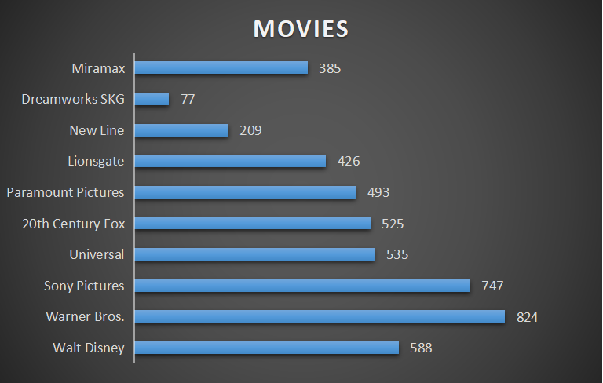
NUMBER OF MOVIES BASED ON TOP DISTRIBUTORS

Slide 10
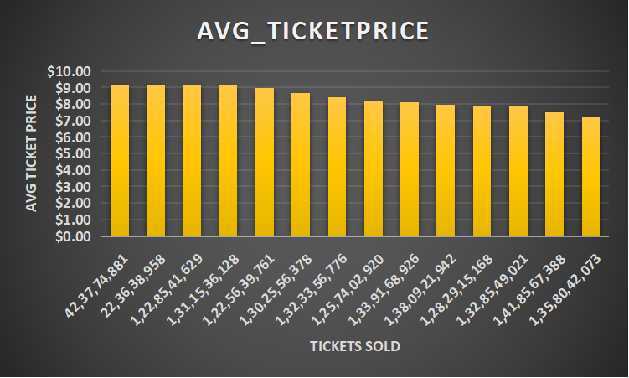
TICKETS SOLD BASED ON AVERAGE TICKET PRICE

Slide 11
TICKETS SOLD BASED ON AVERAGE TICKET PRICE
The column chart represents data of tickets sold when average ticket price is greater than $7.00
A count of 14 years show average ticket price greater than $7.00.

Slide 12
STAR WARS EPSIODES FROM 1995-2021
YEAR | MOVIE | GENRE | MPAA_RATING | DISTRIBUTOR | TOTALFORYEAR | TOTALIN2019 DOLLARS | TICKETS_SOLD
1999 | Star Wars Ep. I: The Phantom Menace | Adventure | PG | 20th Century Fox | $430,443,350 | $776,153,749 | 8,47,32,942
2005 | Star Wars Ep. III: Revenge of the Sith | Action | PG-13 | 20th Century Fox | $380,270,577 | $543,413,171 | 5,93,24,582
2015 | Star Wars Ep. VII: The Force Awakens | Action | PG-13 | Walt Disney | $742,208,942 | $806,480,887 | 8,80,43,765
2017 | Star Wars Ep. VIII: The Last Jedi | Action | PG-13 | Walt Disney | $517,218,368 | $528,173,936 | 5,76,60,910

Slide 13
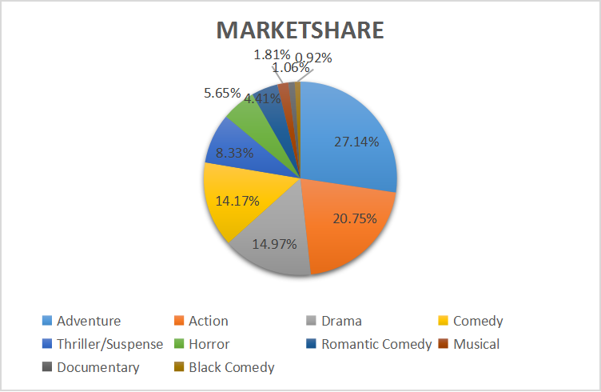
TOP GENRES

Slide 14
TOP GENRES
Market share of Adventure accounts for the maximum ,that is, 27.14%
Action comes second with 20.75% market share
Third comes Drama with 14.97% market share
Documentry and Black Comedy account for the least market shares.

Slide 15
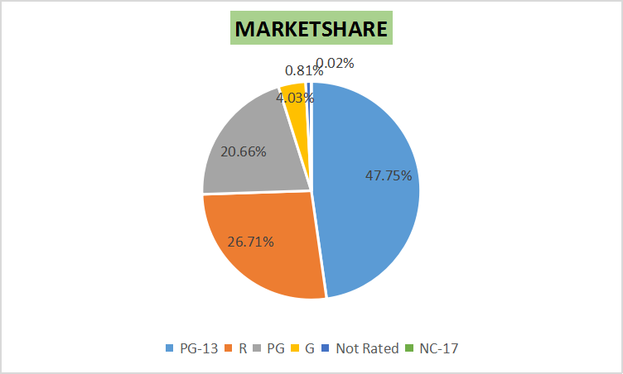
TOP GROSSING RATINGS

Slide 16
TOP GROSSING RATINGS
PG-13 accounts for the maximum market share at 47.75%
R ranks second with 26.71% market share.
PG comes third with 20.66% market share.

Slide 17
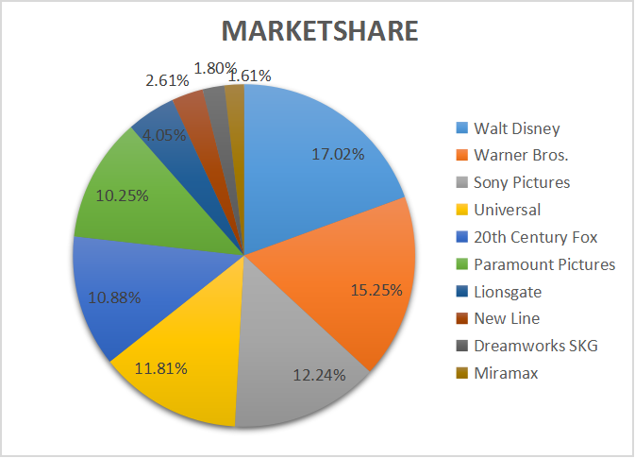
TOP DISTRIBUTORS

Slide 18
TOP DISTRIBUTORS
Walt Disney holds the maximum market share at 17.02%
Warner Bros. ranks second with 15.25% market share
Sony Pictures ranks third with 12.24% market share
New Line, Dreamworks SKG and Miramax account for minimum hold of market shares.

Slide 19
CONCLUSION
This dataset shows the exponential growth of box office collection and average ticket prices over the years.
Finding out the top ranked genres, distributors and grossing ratings has given an idea about the most to least preferred movies.

Slide 20
BIBLIOGRAPHY
https://www.kaggle.com/datasets/johnharshith/hollywood-theatrical-market-synopsis-1995-to-2021

Slide 21
THANK YOU

